Slide 1



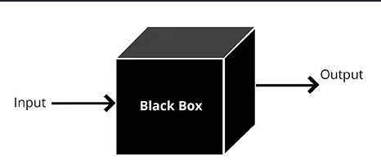
Team 1
Black-box techniques

Slide 2

Team 1
What is the Black-box testing?
Black-box testing is the process of testing an application's functionality without considering its internal structure, design, or code.
The main purpose is to verify whether the software behaves according to the specifications and meets the customer's expectations.

Slide 3
Team 1
There are 4 specification based techniques
Equivalence partitioning
Boundary value analysis
Decision table testing
State transition testing

Slide 4


Team 1
Equivalence partitioning
Apply all levels of software testing.
It divides input data into groups that exhibit similar behavior.
Test cases include valid/invalid data sets, input/output data, internal values.

Slide 5
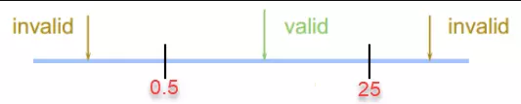
Team 1
Example
On a vegetable at Winmart.
You can order least 0.5 kg and at most 25 kg.
Partition 1: x<0.5 kg
Partition 2: 0.5 kg <= x <= 25 kg
Partition 3: x> 25 kg

Slide 6

Team 1
Boundary value analysis
Can be applied to all levels of software testing.
After applying equivalence partitioning, perform boundary testing between the partitions.
Two-point boundary: <MIN, MIN, MAX, >MAX
Three boundary values: <MIN, MIN, >MIN, <MAX, MAX, >MAX

Slide 7
Team 1
Example
Boundary values: 0.5 and 25
Two-point boundary: 04, 0,5; 25, 25.1
Three boundary values: 0.4, 0.5, 0.6; 24.9, 25, 25.1

Slide 8
Team 1
Decision table testing
Decision table testing is a software testing technique used to test system behavior for different input combinations.
A Decision Table is a tabular representation of inputs versus rules/cases/test conditions.

Slide 9
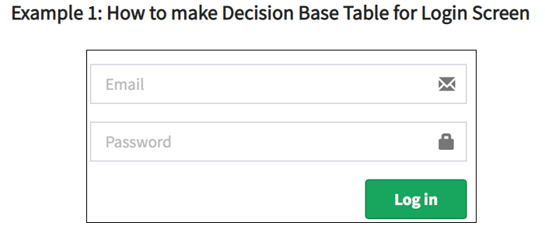
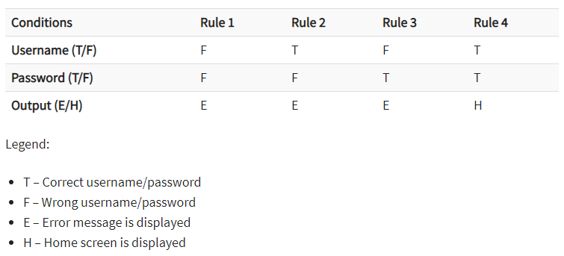
Team 1
Example

Slide 10
Team 1
State transition testing
State Transition Testing is used to test systems that have multiple states and have an impact that changes the state of the system.
State Transition Testing provides a method to help you determine the number of test cases you need to write for a system with complex state transitions.

Slide 11
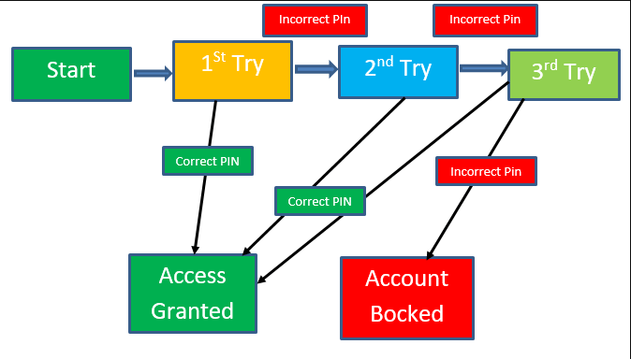
Team 1
Example
ATM machine allows access to an account only if the user enters the correct PIN within 3 attempts.
If the user enters the wrong PIN more than 3 times, the card will be retained by the ATM.
TC1: Start ==> Enter incorrect pin < 3 ==>Access to account
TC2: Start ==> Enter incorrect pin >= 3 ==> Eat Card

Slide 12
Team 1
When to use
Functional testing
Requirement available
QC does not have access to the source code

Slide 13
Team 1
Purpose
To minimize the number of test cases
To identify representative test cases
Cover important rules
To detect defects related to functionality, inputs, outputs, and workflows

Slide 14

Team 1
THANK YOU
PHONE
0913.095.317

